Slide 1

TITANIC SURVIVORS PREDICTION – MACHINE LEARNING
Industrial Training Project Synopsis Presentation
Date: 08/09/2020
Industrial Training and Presentation (ECS791)
Degree : B.Tech (CSE)
Project Guide:
Ms. Rohaila Naaz
Group: XXX
Manish Gupta (TCA1709110)
FACULTY OF ENGINEERING AND COMPUTING SCIENCES
TEERTHANKER MAHAVEER UNIVERSITY, MORADABAD

Slide 2

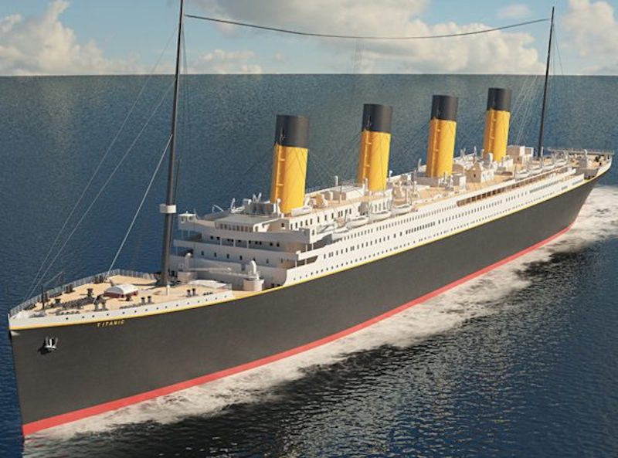
Project Brief
The sinking of the Titanic is one among the foremost infamous shipwrecks in history. While there was some element of luck involved in surviving, it seems some groups of individuals were more likely to survive than others. In this project, my task as a Data Scientist is to build a predictive model that answers the question: “what sorts of people were more likely to survive?” using passenger data (ie name, age, gender, class , etc). The dataset used in this project can be obtained through Kaggle: https://www.kaggle.com/c/titanic
2
T002/ Version 1.0

Slide 3
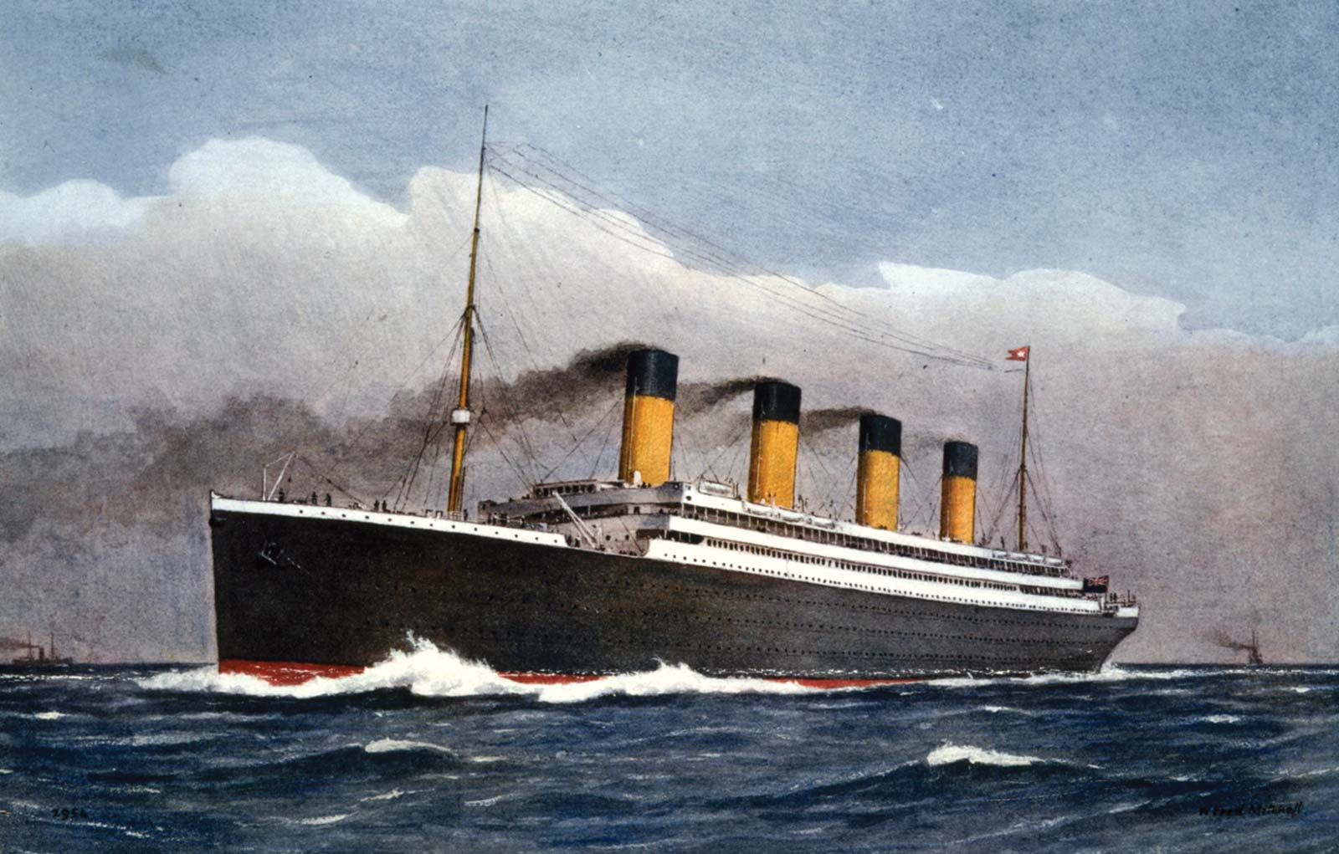
Project Brief
In this project, I built a model to predict who will be the survivors on RMS Titanic, having the Input Dataset containing details of 891 Individuals on board and based on that, we are going to generate a prediction dataset for the Survivors as the output of the Model in our Project. The domain of the Project is Machine Learning, however, since it being and extensive one, just going with Binary Classification problem (Supervised), here for now.
This Project runs on a Web Browser as an IPython ( Jupyter) Notebook which can be run on the Systems having the Anaconda IDE Installed
3
T002/ Version 1.0

Slide 4
Technologies and Tools to be used
  Software Platform
Libraries
Pandas
Numpy
Matplotlib
Scikit Learn
Back-end
Python
Hardware Platform
RAM : at least 4 GB of RAM
Hard Disk : at least 5 GB of Disk Space on Hard Disk
OS : Any Operating System
IDE : Anaconda3 (4.3.1 x64) IDE – Python 3.6.0
4
T002/ Version 1.0

Slide 5
Technologies and Tools to be used
  Tools
Tool Name: IPython Notebooks (Jupyter Notebooks) by Anaconda (4.3.1 x64) IDE
Version: 4.3.1 x64 running on Python 3.6.0
Developer(s): Anaconda Inc. (Continuum Analytics Ltd.)
Written in: Python
Browser Used: Google Chrome (Recommended) or Mozilla Firefox
5
T002/ Version 1.0

Slide 6
Context Diagram (Overall Project)
6
T002/ Version 1.0

Slide 7
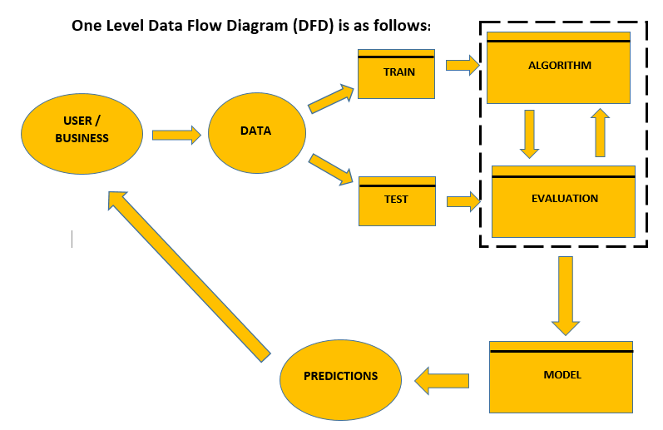
Data Flow Diagram (DFD)
7
T002/ Version 1.0

Slide 8
Advantages of The Project
Can be used cross platform any time subject to IDE availability as it’s an IPython Notebook and can be enhanced by retraining model on same large dataset.
Can Predict Survivors of RMS Titanic with almost 72 percent accuracy in testing phase.
The Same model could be retrained for other similar problems of Binary Classification.
The resultant predictions are almost instantly exported as another dataset by the model.
It is extensively used in the industry with manifestations as other business problems.
The Project doesn’t takes any user data or third party data apart from the input dataset for its usage, being concerned and inclined towards user or business privacy without denying user for accessing any feature of the Project.
8
T002/ Version 1.0

Slide 9
References, if any
a) Books
Advanced Engineering Mathematics by Erwin Keyszig
Higher Engineering Mathematics by BS Grewal and HK Das
Linear Algebra by Gilbert Stang and Think Stats by Allen B Downey
Software Engineering Principles and Practices by Roger Pressman
b) Websites
www.google.com
www.trainings.internshala.com
www.youtube.com
www.edx.com
www.kaggle.com
www.stackoverflow.com
www.geeksforgeeks.com
9
T002/ Version 1.0

Slide 10

End of Project Synopsis Presentation

